Slide 1
Algorithms: Greedy Method
Knapsack Problem

Slide 2

Greedy Algorithms: Principles
A greedy algorithm always makes the choice that looks best at the moment.
A greedy algorithm works in phases.
At each phase:
You take the best you can get right now, without regard for future consequences.
You hope that by choosing a local optimum at each step, you will end up at a global optimum.
For some problems, it works.

Slide 3
The Knapsack Problem
The famous Knapsack Problem:
A thief breaks into a museum. Fabulous paintings, sculptures, and jewels are everywhere. The thief has a good eye for the value of these objects, and knows that each will fetch hundreds or thousands of dollars on the clandestine art collector’s market. But, the thief has only brought a single knapsack to the scene of the robbery, and can take away only what he can carry. What items should the thief take to maximize the haul?
Which items should I take?

Slide 4
The Knapsack Problem
There are two versions of the problem:
(1) “0-1 knapsack problem”
Items are indivisible: you either take an item or not. Solved with dynamic programming.
(2) “Fractional knapsack problem”
Items are divisible: you can take any fraction of an item. Solved with a greedy algorithm.

Slide 5
The Knapsack Problem
More formally, the 0-1 knapsack problem:
The thief must choose among n items, where the ith item worth v_{i} dollars and weighs w_{i} pounds
Carrying at most W pounds, maximize value
Note: assume v_{i}, w_{i}, and W are all integers
“0-1” because each item must be taken or left in entirety
A variation, the fractional knapsack problem:
Thief can take fractions of items
Think of items in 0-1 problem as gold ingots, in fractional problem as buckets of gold dust.

Slide 6
Optimal Substructure Property
Both problems exhibit the optimal substructure property.
To show this for both the problems, consider the most valuable load weighing at most W pounds
Q: If we remove item j from the load, what do we know about the remaining load?
A: The remaining load must be the most valuable load weighing at most W - w_{j} that the thief could take from the n-1 original items excluding item j.

Slide 7
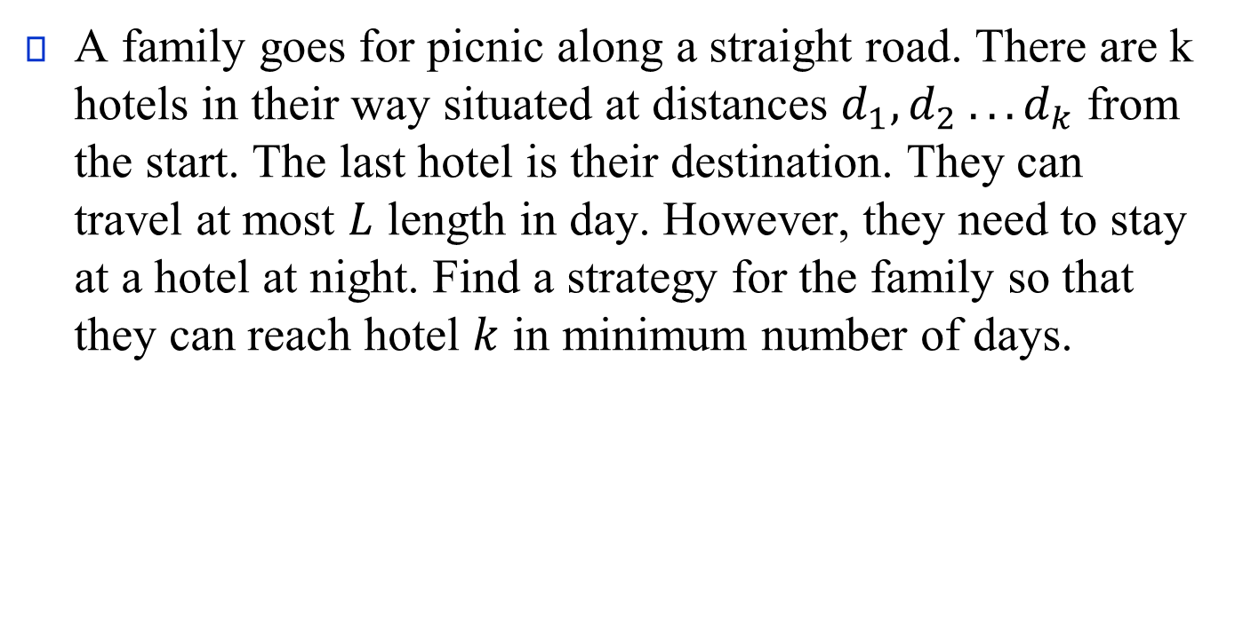
Problem 1
A family goes for picnic along a straight road. There are k hotels in their way situated at distances $d_{1},d_{2} . . . d_{k}$ from the start. The last hotel is their destination. They can travel at most $L$ length in day. However, they need to stay at a hotel at night. Find a strategy for the family so that they can reach hotel $k$ in minimum number of days.

Slide 8
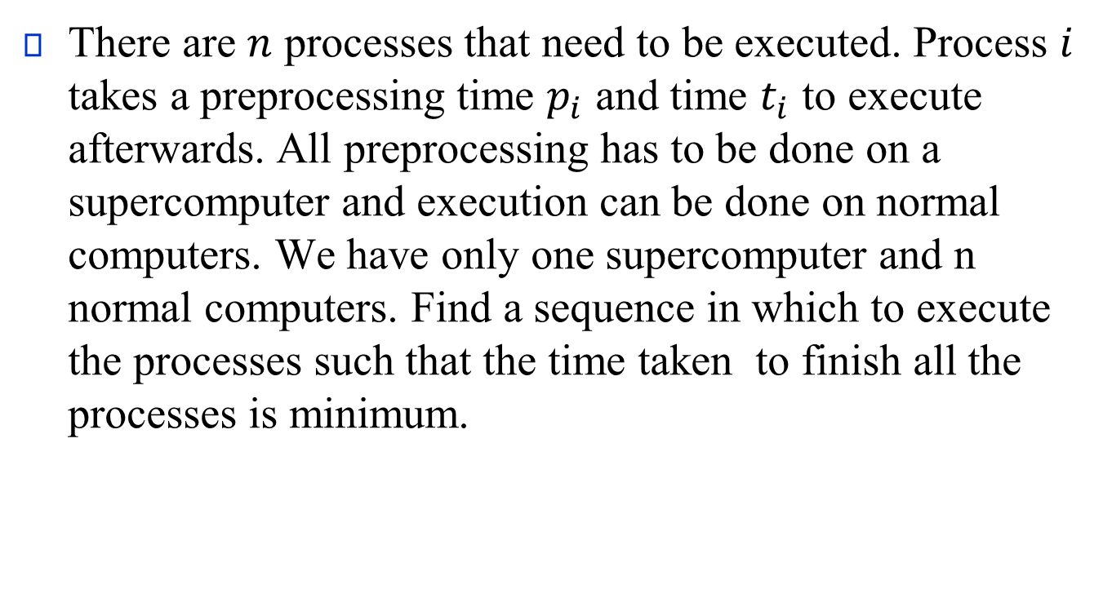
Problem 2
There are $n$ processes that need to be executed. Process $i$ takes a preprocessing time $p_{i}$ and time $t_{i}$ to execute afterwards. All preprocessing has to be done on a supercomputer and execution can be done on normal computers. We have only one supercomputer and n normal computers. Find a sequence in which to execute the processes such that the time taken to finish all the processes is minimum.

Slide 9
Fractional Knapsack Problem
Knapsack capacity: W
There are n items: the i-th item has value v_{i} and weight w_{i}
Goal:
find x_{i} such that for all 0 ≤ x_{i} ≤ 1, i = 1, 2, .., n
∑ w_{i}x_{i} ≤ W and
∑ x_{i}v_{i} is maximum
Notes:
9

Slide 10
Fractional Knapsack - Example
50
20
---
30
50
$80
+
Item 3
Item 2
30
20
$100
+
Item 1
20
10
10
$60
$60
$100
$120
$240
$6/pound
$5/pound
$4/pound
Notes:
10

Slide 11
Fractional Knapsack Problem
Greedy strategy:
Pick the item with the maximum value per pound v_{i}/w_{i}
If the supply of that element is exhausted and the thief can carry more: take as much as possible from the item with the next greatest value per pound
It is good to order items based on their value per pound

Slide 12
Fractional Knapsack Problem
Alg.: Fractional-Knapsack (W, v[n], w[n])
while w > 0 and as long as there are items remaining
pick item with maximum v_{i}/w_{i}
x_{i} ← min (1, w/w_{i})
remove item i from list
w ← w – x_{i}w_{i}
w – the amount of space remaining in the knapsack (initially w = W)
Running time: Θ(n) if items already ordered; else Θ(nlogn)

Slide 13
0-1 Knapsack problem
Thief has a knapsack with maximum capacity W, and a set S consisting of n items
Each item i has some weight w_{i} and benefit value v_{i} (all w_{i} , v_{i} and W are integer values)
Problem: How to pack the knapsack to achieve maximum total value of packed items?
Goal:
find x_{i} such that for all x_{i} ∈ {0, 1}, i = 1, 2, .., n
∑ w_{i}x_{i} ≤ W and
∑ x_{i}v_{i} is maximum

Slide 14
0-1 Knapsack - Greedy Strategy Fails
50
50
50
30
Item 3
$120
+
Item 2
30
20
$100
+
Item 1
20
20
$100
10
10
$60
$60
$100
$120
W
$160
$220
$6/pound
$5/pound
$4/pound

Slide 15
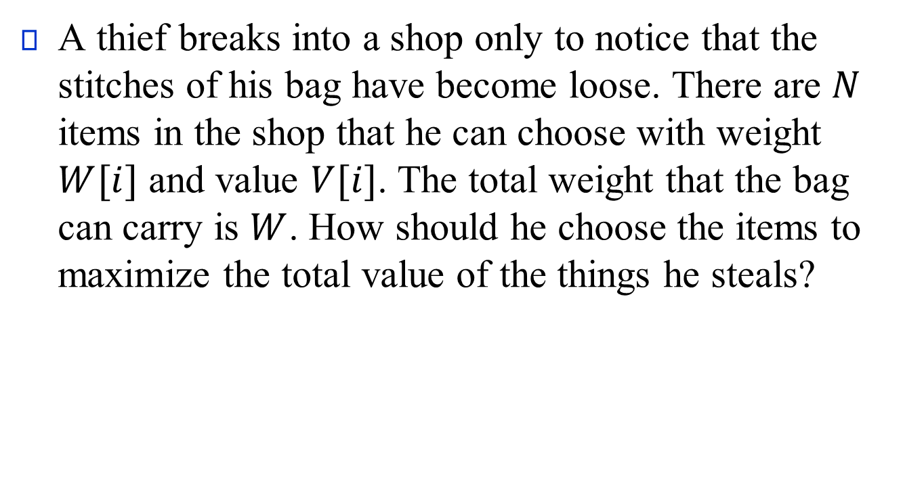
A thief breaks into a shop only to notice that the stitches of his bag have become loose. There are $N$ items in the shop that he can choose with weight $W[i]$ and value $V[i]$. The total weight that the bag can carry is $W$. How should he choose the items to maximize the total value of the things he steals?

